Slide 1
HOSPITAL MANAGEMENT SYSTEM
INF 6210: Database Management Database Design
Instructor: Prof. Mutsalklisana

Slide 2
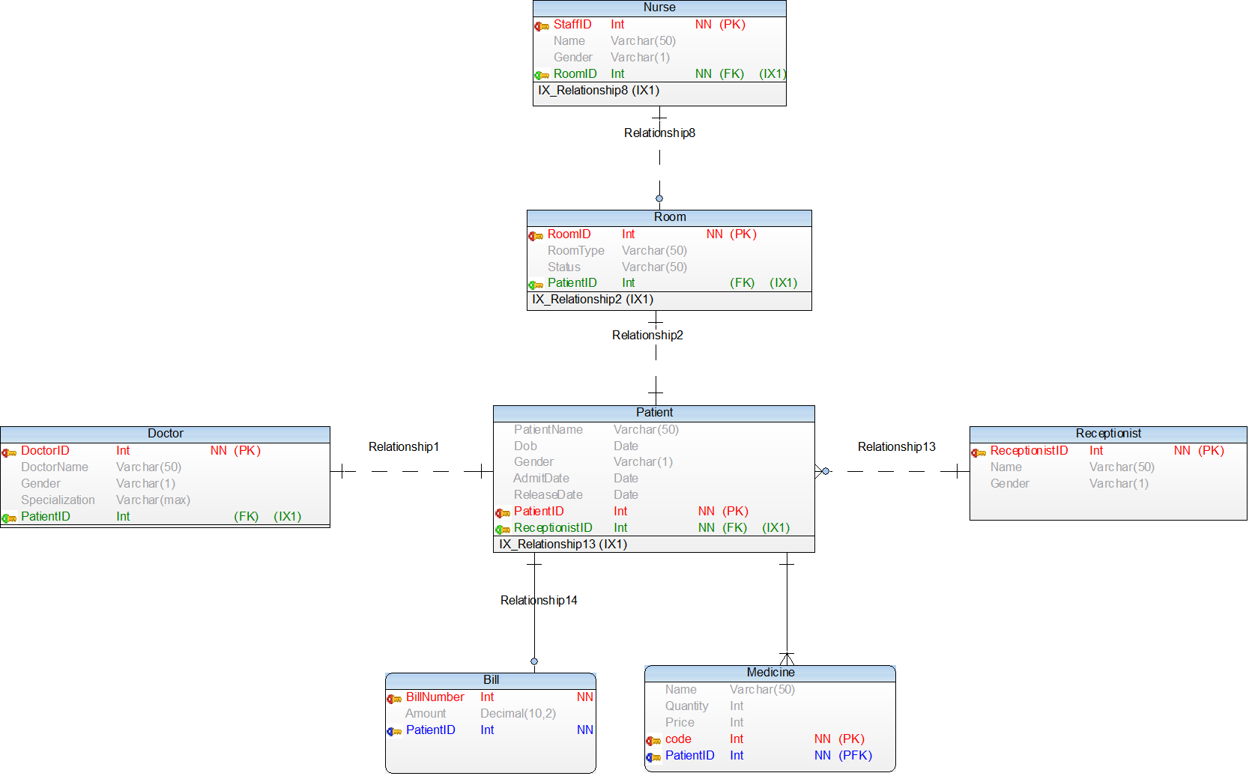
EER Diagram

Slide 3
Create Database
CREATE command is used for creating database
DROP command is use for dropping a database

Slide 4
Use Database
USE command is used for using a particular database
SET command is used for safe delete

Slide 5
Table Creation
Model has seven tables in the model. They are:
Patient
Doctor
Receptionist
Nurse
Room
Medicine
Bill

Slide 6
Table Creation
CREATE command is used for creating table
In practice, they are usually created in the implementation phase later on in the development process
However, we create them here to explain some concepts
One table is created for each table shown in the relational schema

Slide 7
Table Creation
Each attribute is defined, taking the data type and length from the domain definitions
For example, the attribute Patient_Name can be defined as a VARCHAR (variable character) type with length 25
By specifying NOT NULL, each attribute can be constrained from being assigned a null value
The primary key for each table is specified using the PRIMARY KEY clause at the end of each table definition

Slide 8
PRIMARY KEY
A primary key is a special relational database table column (or combination of columns) designated to uniquely identify all table records.
A primary key’s main features are: – It must contain a unique value for each row of data. – It cannot contain null values.
A primary key is either an existing table column or a column that is specifically generated by the database according to a defined sequence.
On some RDBMS a primary key automatically generates a clustered table index by default.

Slide 9
REFERENTIAL INTEGRITY CONSTRAINTS
Referential integrity constraints are easily defined using the graphical schema
An arrow originates from each foreign key and points to the related primary key in the associated relation
In SQL, a FOREIGN KEY REFERENCES statement corresponds to one of these arrows
The foreign key Patient_ID references the primary key of Patient, which is also Patient_ID
Although here the foreign and primary keys have the same name, this need not be the case – but the foreign and primary keys must be from the same domain

Slide 10
PATIENT Table Create

Slide 11
DOCTOR Table

Slide 12
RECEPTIONIST Table

Slide 13
BILL Table

Slide 14
ROOM Table

Slide 15
NURSE Table

Slide 16
MEDICINE Table

Slide 17
Use Database
USE command is used for using a particular database
SET command is used for safe delete

Slide 18
SET Command
SET command is used for safe delete

Slide 19
SET Command
SET command is also used for updating the column or row in a table

Slide 20
INSERT INTO Table
Model has seven tables in the model. They are:
Patient
Doctor
Receptionist
Nurse
Room
Medicine
Bill

Slide 21
Create Relation Table
INSERT command is used for inserting data into the table
One table is created, the data is inserted into the table based on the relationships between the table

Slide 22
PRIMARY KEY
A primary key is a special relational database table column (or combination of columns) designated to uniquely identify all table records.
A primary key’s main features are: – It must contain a unique value for each row of data. – It cannot contain null values.
A primary key is either an existing table column or a column that is specifically generated by the database according to a defined sequence.
On some RDBMS a primary key automatically generates a clustered table index by default.

Slide 23
REFERENTIAL INTEGRITY CONSTRAINTS
Referential integrity constraints are easily defined using the graphical schema
An arrow originates from each foreign key and points to the related primary key in the associated relation
In SQL, a FOREIGN KEY REFERENCES statement corresponds to one of these arrows
The foreign key Patient_ID references the primary key of Patient, which is also Patient_ID
Although here the foreign and primary keys have the same name, this need not be the case – but the foreign and primary keys must be from the same domain

Slide 24
INSERTION into PATIENT Table

Slide 25
INSERTION into DOCTOR Table

Slide 26
INSERTION into NURSE Table

Slide 27
INSERTION into ROOM Table

Slide 28
INSERTION into RECEPTIONIST Table

Slide 29
INSERTION into MEDICINE Table

Slide 30
INSERTION into BILL TABLE

Slide 31
INDEX
When you query data from a table, first MySQL checks if the indexes exist, then MySQL uses the indexes to select exact physical corresponding rows of the table instead of scanning the whole table. A database index is similar to an index of a book.

Slide 32
Select Query
What is the SELECT Query?
A select query is simply a data retrieval query. An action query can ask for additional operations on the data, such as insertion, updating, or deletion. Languages used to interact with databases are called query languages, of which the Structured Query Language (SQL) is the well-known standard.
SYNTAX
SELECT column1, column2, columnN FROM table_name;

Slide 33
Select Query
This query selects all the patient from patient table

Slide 34
Where Clause
What is WHERE clause?
WHERE clauses are not mandatory clauses of SQL DML statements, but can be used to limit the number of rows affected by a SQL DML statement or returned by a query. In brief SQL WHERE clause is used to extract only those results from a SQL statement, such as: SELECT, INSERT, UPDATE, or DELETE statement.
SYNTAX
SELECT column1, column2, columnN FROM table_name WHERE [condition]

Slide 35
Where Clause
The below query give the list of all the patients who are currently admittied into the hospital.

Slide 36
LIMIT Clause
What is LIMIT clause?
The SQL SELECT LIMIT statement is used to retrieve records from one or more tables in a database and limit the number of records returned based on a limit value. SELECT LIMIT is not supported in all SQL databases. For databases such as SQL Server or MSAccess, use the SELECT TOP statement to limit your results.
SYNTAX
SELECT column1, column2, columnN FROM table_name LIMIT [no of rows]

Slide 37
LIMIT Clause
First 10 Receptionist name in the List
The below query returns 1 to 20 bills from the list

Slide 38
ORDER BY
What is ORDER BY clause?
An ORDER BY clause in SQL specifies that a SQL SELECT statement returns a result set with the rows being sorted by the values of one or more columns. The sort criteria do not have to be included in the result set.
SYNTAX
SELECT column-list FROM table_name [WHERE condition] [ORDER BY column1, column2, .. columnN] [ASC | DESC];

Slide 39
ORDER BY
The sorted list of Medicine based on price in ascending order

Slide 40
GROUP BY
What is GROUP BY clause?
Groups a selected set of rows into a set of summary rows by the values of one or more columns or expressions in SQL Server 2016. One row is returned for each group. Aggregate functions in the SELECT clause<select> list provide information about each group instead of individual rows.
SYNTAX
SELECT column1, column2 FROM table_name WHERE [ conditions ] GROUP BY column1, column2 ORDER BY column1, column2

Slide 41
GROUP BY
The below query is going to return the number of rooms based on their type and sorted in ascending order

Slide 42
HAVING Clause
What is HAVING Clause?
A HAVING clause in SQL specifies that an SQL SELECT statement should only return rows where aggregate values meet the specified conditions. It was added to the SQL language because the WHERE keyword could not be used with aggregate functions.
SYNTAX
SELECT FROM WHERE GROUP BY HAVING ORDER BY

Slide 43
Having Clause
The below query is going to return the name of the doctor who specialization starts from letter ‘D’

Slide 44
CATEGORIES
DDL: Data Definition Language
DML: Data Manipulation Language
TCL: Transaction Control Language
DCL: Data Control Language

Slide 45
DDL
What can it do?
It is used to alter database structure
Create database objects
Update database objects 
Delete database objects

Slide 46
FUNCTIONS
Mathematical
String
Date/Time
Conditional
System Information
Encryption
Formatting

Slide 47
MATHEMATICAL
COUNT – To get the number of records in the tables
The query is going to return the count of doctor based on their specialization

Slide 48
MATHEMATICAL
MAX – To get the maximum value of the records
The query is going to return the max of the patient name in the available list.

Slide 49
MATHEMATICAL
AVG – To get the average value of the records: Numbers only
ABS(x) – To get the absolute value of x.

Slide 50
STRING
Upper(x)/Ucase(x) – To convert all characters of x to upper case
Lower(x)/Lcase(x) – To convert all characters of x to lower case
Strcmp(s1,s2) – Return s1 > s2 ? 1 : s1 == s2 ? 0 :-1

Slide 51
DATE & TIME
CurDate()/CurrentDate() – get current date 
CurTime()/CurrentTime() – get current time

Slide 52
DATE & TIME
Year(d)/Quarter(d)/Hour(t)/Minute(t)/Second(t)
Now()/current_timestamp()/localtime()/sysdate() – get current date and time

Slide 53
SYSTEM INFORMATION
Version ()– get version of current database
Connection_ID() – get number of connections to the server 
Database() /Schema() – get database name

Slide 54
JOINS
What are JOINS?
A SQL join clause combines records from two or more tables in a relational database. It creates a set that can be saved as a table or used as it is. A JOIN is a means for combining fields from two tables (or more) by using values common to each.
A JOIN is a means for combining fields from two tables by using values common to each.

Slide 55
WHY USE JOINS
In a normalized database, groups of data are stored in individual tables, and relationships are established between those tables to link related data - access data in different tables to carry out an operation affected by those relationships
To support the capability to access data in multiple tables, SQL allows you to create joins in a statement that define how data is accessed in multiple tables
Most commonly used in select statements, but can also be used in update and delete statements

Slide 56
TYPE OF JOIN STATEMENT
INNER JOIN: returns rows when there is a match in both tables.
LEFT JOIN: returns all rows from the left table, even if there are no matches in the right table.
RIGHT JOIN: returns all rows from the right table, even if there are no matches in the left table.
FULL JOIN: returns rows when there is a match in one of the tables.
SELF JOIN: is used to join a table to itself as if the table were two tables, temporarily renaming at least one table in the SQL statement.
CARTESIAN JOIN: returns the Cartesian product of the sets of records from the two or more joined tables.

Slide 57
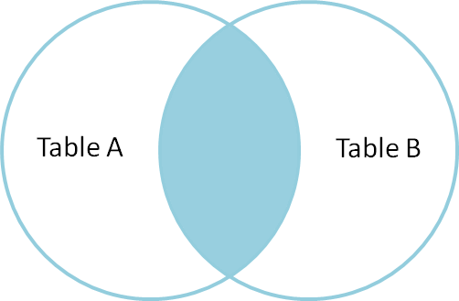
INNER JOIN
An inner join produces a result set that is limited to the rows where there is a match in both tables for what we're looking for.
If you don't know which kind of join you need, this will usually be your best bet.

Slide 58
INNER JOIN
The query is going to return the patient name and medicine taken by them for the medicines whose price is greater than 7000.

Slide 59
INNER JOIN
The query is going to return the list of all the patients with their room ID who are admit in ‘Semi-Private’ room.

Slide 60
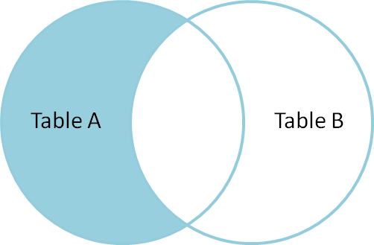
LEFT OUTER JOIN
A LEFT OUTER JOIN is one of the JOIN operations that allow you to specify a join clause. It preserves the unmatched rows from the first (left) table, joining them with a NULL row in the shape of the second (right) table.

Slide 61
LEFT OUTER JOIN
The query is going to return the list of all the nurses allotted to the emergency room type.

Slide 62
LEFT OUTER JOIN
The query is going to return the list of all the male nurses and the room allotted to them.

Slide 63
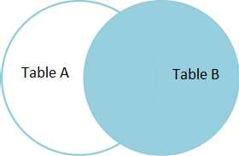
RIGHT OUTER JOIN
A RIGHT OUTER JOIN is one of the JOIN operations that allow you to specify a JOIN clause. It preserves the unmatched rows from the second (right) table, joining them with a NULL in the shape of the first (left) table. A LEFT OUTER JOIN B is equivalent to B RIGHT OUTER JOIN A, with the columns in a different order.

Slide 64
RIGHT OUTER JOIN
The query is going to return the list of the medicine given to the patient who are admitted after 1st January, 2014

Slide 65
RIGHT OUTER JOIN
The right outer join is performed on the patient and doctor table to retrive the list of all the patients attended by doctors.

Slide 66
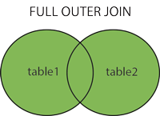
FULL JOIN
A full outer join, or just outer join, produces a result set with all of the rows of both tables, regardless of whether there are any matches. Similarly to the left and right joins, we call the empty spaces null.

Slide 67
FULL OUTER JOIN
This query is going to return the list of all the nurses and room from the database.

Slide 68
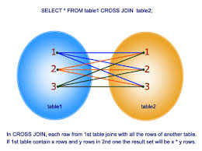
CROSS JOIN
The cross join returns a table with a potentially very large number of rows. The row count of the result is equal to the number of rows in the first table times the number of rows in the second table. Each row is a combination of the rows of the first and second table.

Slide 69
CROSS JOIN

Slide 70
Queries within Queries
SQL allows queries within queries, or subqueries, which are SELECT statements inside SELECT statements.
Subqueries can actually be very useful however, is that they can consume a lot of processing, disk, and memory resources.
A subquery’s syntax is just the same as a normal SELECT query’s syntax.
As with a normal SELECT statement, a subquery can contain joins, WHERE clauses, HAVING clauses, and GROUP BY clauses.
Subqueries are particularly powerful when coupled with SQL operators such as IN, ANY, SOME, and ALL.
Note: versions of MySQL prior to version 4.1 do not fully support subqueries

Slide 71
SUB QUERY
What is a SUBQUERY?
A subquery is a query within another query, also known as a nested query. A subquery is used to return data that will be used in the main query as a condition to further restrict the data to be retrieved. Subqueries are used with the SELECT, INSERT, UPDATE, and DELETE statements.
SYNTAX
( SELECT [DISTINCT] subquery_select_parameter FROM {table_name | view_name} {table_name | view_name} ... [WHERE search_conditions] [GROUP BY column_name [,column_name ] ...] [HAVING search_conditions] )

Slide 72
SUB QUERY
The query is going to return the list of patients whose bill amount is greater than 80,000.

Slide 73
SUB QUERY within SUB QUERY
This query is going to return the doctor name of the patient whose has the maximum bill amount.

Slide 74
Sub queries in a SELECT list
You can include a subquery as one of the expressions returning a value in a SELECT query, just as you can include a single column.
However, the subquery must return just one record in one expression, in what is known as a scalar subquery.
The subquery must also be enclosed in brackets.

Slide 75
OPERATOR
What is an Operator in SQL?
An operator is a reserved word or a character used primarily in an SQL statement's WHERE clause to perform operation(s), such as comparisons and arithmetic operations.
Operators are used to specify conditions in an SQL statement and to serve as conjunctions for multiple conditions in a statement.

Slide 76
IN OPERATOR
The IN operator is used to compare a value to a list of literal values that have been specified.

Slide 77
SOME & ANY OPERATOR
First, ANY and SOME are identical; they do the same thing but have a different name.
The examples refer to the ANY operator, but you can use the SOME operator without it making a bit of
difference.
For ANY to return true to a match, the value being compared needs to match any one of the values returned by the subquery.
You must place the comparison operator before the ANY keyword.
For example, the following SQL uses the equality (=) operator to find out if any members have the same

Slide 78
SOME & ANY OPERATOR
SOME & ANY is a logical Operator in SQL
The ANY operator is used to compare a value to any applicable value in the list according to the condition.

Slide 79
USERS
To enable the user to connect with no password, include no IDENTIFIED BY clause
To assign a password, use IDENTIFIED BY with the literal clear text password.
DROP USER

Slide 80
PRIVILEGES
What are Privileges?
Most relational databases allow you to restrict each user’s access to specifictables and even columns within a table
Typically you would fine groups such as Clerks or Managers and then grant permission for users in those groups to view certain data. You may also be able to grant exceptions for individual users

Slide 81
GRANT AND REVOKE
SQL GRANT and REVOKE statements let you give and withdraw privileges
It is generally safest & most recommended to give users the fewest privileges possible to do their jobs
Then if an application contains a bug and accidentally tries to do something stupid, such as dropping a table or showing the user sensitive information, the database won’t allow it
Rather than remembering to remove every extraneous privilege from a new user, many database administrators revoke all privileges and then grant those that are needed
That way the administrator cannot forget to remove some critical privilege

Slide 82
GRANT SYNTAX
For Database:
GRANT ALL ON mydb.* TO 'someuser'@'somehost‘;
GRANT SELECT, INSERT ON mydb.* TO 'someuser'@'somehost’;
For Tables:
GRANT ALL ON mydb.mytbl TO 'someuser'@'somehost’;
GRANT SELECT, INSERT ON mydb.mytbl TO 'someuser'@'somehost’;
For Columns:
GRANT SELECT(col1), INSERT(col1,col2) ON mydb.mytbl TO 'someuser'@'somehost';
For Stored Routines
GRANT CREATE ROUTINE ON mydb.* TO 'someuser'@'somehost’;
GRANT EXECUTE ON PROCEDURE mydb.myproc TO 'someuser'@'somehost';

Slide 83
REVOKE SYNTAX
REVOKE priv_type [(column_list)] [, priv_type [(column_list)]] ... ON [object_type] priv_level FROM user [, user]
REVOKE ALL PRIVILEGES, GRANT OPTION FROM user [, user] ...
Example:
REVOKE INSERT ON *.* FROM 'jeffrey'@'localhost’;
REVOKE ALL PRIVILEGES, GRANT OPTION FROM user [, user] ...

Slide 84
EXAMPLE
We will create 4 users and grant and revoke permissions to them
Four users will be:
Admin
Developer
Tester
User

Slide 85
ADMIN
The below query is going to create the user with the username: admin, password: admin.
Grant the permission for everything on Hospital database.

Slide 86
DEVELOPER
The below query is going to create the user with the username: developer, password: developer.
Grant the SELECT, INSERT permission on patient table in Hospital database.

Slide 87
TESTER
The below query is going to create the user with the username: tester, password: tester.
Grant the SELECT, INSERT permission on Patient, Receptionist table in Hospital database.

Slide 88
TESTER
Revoke INSERT permission from Tester in Hospital database.

Slide 89
USER
The below query is going to create the user with the username: user, password: user.
Grant the SELECT on columns and INSERT permission on columns in Patient table in Hospital database.

Slide 90
STORE PROCEDURE
What is a STORE PROCEDURE?
A stored procedure is an executable database object that contains one or more SQL statements
A stored procedure is also called a sproc (pronounced either as one word or as “ess-proc”) or a procedure.
Stored procedures are pre-compiled
That means that the execution plan for the SQL code is compiled the first time the procedure is executed and is then saved in its compiled form
For this reason, stored procedures execute faster than an equivalent SQL script

Slide 91
STORE PROCEDURE
You use the EXEC statement to run, or call, a procedure.
If this statement is the first line in a batch, you can omit the EXEC keyword and code just the procedure name
To make your code easier to read, however, you should always include the EXEC keyword
You can call a stored procedure from within another stored procedure
A stored procedure can be call from within itself
This technique, called a recursive call or recursion, is seldom used in SQL programming

Slide 92
Advantage of Store Procedure
One of the advantages of using procedures is that application programmers and end users don’t need to know the structure of the database or how to code SQL
Another advantage of using procedures is that they can restrict and control access to a database
If you use procedures in this way, you can prevent both accidental errors and malicious damage

Slide 93
CREATE STORE PROCEDURE
Use CREATE PROC statement to create a stored procedure
Code the name of the procedure in the CREATE PROC clause
Stored procedure names can’t be the same name as the name of any other object in the database
Also good practice, to prefix its name with the letter “sp” to help distinguish a store procedure from other DB objects

Slide 94
SYNTAX
CREATE [OR REPLACE] PROCEDURE procedure_name
[(parameter_name [IN | OUT | IN OUT] type [, ...])]
{IS | AS}
BEGIN
< procedure_body >
END
procedure_name;

Slide 95
EXAMPLE 1
Write a procedure which to going to update the release date of a patient as soon as patient is going to be release from the hospital.
We execute the procedure using CALL command.

Slide 96
EXAMPLE 1

Slide 97
EXAMPLE 2
The below procedure is for generating the bill as soon patient is release from the hospital and updating the release date of the patient.

Slide 98
EXAMPLE 2
How to call a store procedure?
Using the SET command patientID is set who is going to be released from the hospital.
We are using CALL command preceded by procedure name
SELECT statement is used for displaying the result.

Slide 99
TRANSACTION
In almost all applications that access SQL databases, multiple users concurrently attempt to view and modify data
The simultaneous operations may result in data that is inconsistent and inaccurate Or worse, database corruption!
Using “Transactions” avoid these problems by isolating each operation

Slide 100
TRANSACTIONS IN SQL & RDBMS
In the context of SQL and relational databases,
– Transaction is a set of one or more SQL statements that perform a set of related actions
– The statements are grouped together and treated as a single unit whose success or failure depends on the successful execution of each statement in the transaction.
• In addition to ensuring the proper execution of a set of SQL statements,
– Transaction locks the tables involved in the transaction so that other users cannot modify any rows that are involved in the transaction

Slide 101
ACID
What is ACID?
ATOMICITY (A) – ALL or NO operations in a transaction are performed; Transaction Recovery System – ensures atomicity and enables the all or nothing output
CONSISTENCY (C) – consistent state is maintained before a transaction starts and after it concludes
ISOLATION (I) – concurrent transactions DO NOT interfere with each other; Partial results of incomplete transactions are not visible to others before the transactions are committed.
DURABILITY (D) – transactions results are locked/ permanent after being committed; System guarantees that results of a committed transaction will be permanent even if a failure occurs after the commit

Slide 102
Transaction – ACID Relationship
Generally, every transaction is ACID
Atomicity-Consistency-Isolation-Durability compliant in accordance with concurrency control and transparency in the DB
It is NOT required, but the best DB transactions are ‘ACID friendly’

Slide 103
START TRANSACTION
START TRANSACTION statement requires no clauses or options:
START TRANSACTION
START TRANSACTION statement notifies MySQL that the statements that follow should be treated as a unit, until the transaction ends, successfully or otherwise

Slide 104
COMMIT STATEMENT
COMMIT Statement commit a transaction
COMMIT statement is used to terminate a transaction and to save all changes made by the transaction to the database. There are no additional clauses or options:
COMMIT

Slide 105
SAVEPOINT
SAVEPOINT and ROLLBACK TO SAVEPOINT
statements isolate portions of a transaction
SAVEPOINT statement defines a marker in a transaction, and
the ROLLBACK TO SAVEPOINT statement allows you to roll back a transaction to a predetermined marker (savepoint)

Slide 106
EXAMPLE

Slide 107
OUTPUT
OUTPUT after first update statement
After the rollback when select statement is run again

Slide 108
LOCK TABLES & UNLOCK TABLES
Lock one or more tables, table partitions or subpartitions in a specified mode
Manually overrides automatic locking and permits or denies access to a table or view by other users for the duration of operation
SYNTAX
LOCK TABLES tbl_name
[[AS] alias] lock_type [, tbl_name
[[AS] alias] lock_type] ...
lock_type: READ [LOCAL] | [LOW_PRIORITY] WRITE
UNLOCK TABLES

Slide 109
EXAMPLE

Slide 110
OUTPUT
ONCE the READ LOCK statement is executed on table
And after that, when you are going to run the update command on table. Following error will be shown:
After the UNLOCK statement, the update query will run normally.

Slide 111
TRIGGER
Triggers are similar to stored procedures in that they are self-contained units of SQL code.
You don’t explicitly call a trigger, as you do with a stored procedure
Automatically trigger invokes when a predefined event occurs
Triggers exist in most DBMS to manage and monitor tables during insert, update or delete.

Slide 112
Purpose of Trigger
Purpose of Triggers:
Log changes on records
Validation
Create backup or duplicate information (data/object)

Slide 113
TRIGGER SYNTAX
CREATE TRIGGER Syntax:
CREATE TRIGGER <trigger name> {BEFORE | AFTER}
{INSERT | UPDATE | DELETE}
ON <table name>
FOR EACH ROW
<Triggered SQL statement>

Slide 114
TRIGGER
How many times should the trigger body execute when the triggering event takes place?
Per Statement: the trigger body executes once for the triggering event (This is the default)
For each row: the trigger body executes once for each row affected by the triggering event
When the trigger can be fired?
Relative to the execution of an SQL statement (BEFORE or AFTER or instead of it)
Exactly in a situation depending on specific system resources (e.g., signal from system clock)

Slide 115
TYPES OF TRIGGER
Most RDMSs generally support three types of triggers:
INSERT
UPDATE
DELETE
Regardless of the type of trigger, define it on a specific table, and when a related event occurs, the trigger is fired

Slide 116
TRIGGER EVENT
INSERT:
If define an INSERT trigger on a table, the trigger is fired when data is inserted in the table
UPDATE:
If define an UPDATE trigger on a table, the trigger is fired when the table is updated
DELETE:
If define an DELETE trigger on a table, the trigger is fired when data is deleted from

Slide 117
INSERT TRIGGER
The below trigger is fired as soon as a patient is admitted to hospital, he will be allotted a room from the list which is empty.

Slide 118
INSERT TRIGGER
Trigger is already compiled and store. As soon as INSERT command is executed on PATIENT Table getRoom trigger is fired.
OUTPUT: PatientID = 51 is allotted a room 51.

Slide 119
UPDATE TRIGGER
Update trigger

Slide 120
DELETE TRIGGER
The below trigger is fired when delete query is executed on PATIENT table.
The deletePatient trigger is going to delete the patient from the BILL & MEDICINE table.

Slide 121
DELETE TRIGGER
Set of command is executed to check the output
Foreign key checks is SET to zero for safe delete.

Slide 122
DELETE TRIGGER
Once the trigger is fired. Room status is changed to ‘Empty’ and patientID is removed. It means room is again available to occupy.
Entry from current Bill and Medicine table is deleted as well.

Slide 123
SQL VIEW
A view is a virtual table based on the result of SQL statement, allow users to do the followings:
Structure data in way that users or classes of users find natural or intuitive
Restrict access to the data such that a user can see and (sometimes) modify exactly what they need and no more
Summarize data from various tables which can be used to generate reports

Slide 124
SQL VIEW
A view is a virtual table based on the result of SQL statement
A view contains rows and columns, just like a real table
Fields in a view are fields from one or more real tables in the database
Function such as WHERE & JOIN statements can be added a view statement and present the data as if the data were coming from one single table.

Slide 125
CREATE VIEW SYNTAX
CREATE
[OR REPLACE]
[ALGORITHM = {UNDEFINED | MERGE | TEMPTABLE}]
[DEFINER = { user | CURRENT_USER }]
[SQL SECURITY { DEFINER | INVOKER }]
VIEW view_name [(column_list)]
AS select_statement
[WITH [CASCADED | LOCAL] CHECK OPTION]

Slide 126
BENEFITS OF VIEW
A view provides several benefits: • Views can hide complexity
If you have a query that requires joining several tables, or has complex logic or calculation, you can code all that logic into a view, then select from the view just like you would a table
Views can be used as a security mechanism
A view can select certain columns and/or rows from a table, and permission set on the view instead of the underlying tables. This allow surfacing only the data that a user needs to see

Slide 127
BENEFITS OF VIEW
Views can simplify supporting legacy code
If you need to refactor a table that would break a lot of code, you can replace the table with a view of the same name
The view provides the exact same schema as the original table, while the actual schema has changed
This keep the legacy code that references the table from breaking, allowing you to change the legacy code at your leisure

Slide 128
EXAMPLE 1
The view is created for showing the CARDIOLOGIST doctors only

Slide 129
EXAMPLE 2
The view is representing the list of doctors with their ID’s whose earning are greater than average.

Slide 130
EXAMPLE 3
The view is created to represent available emergency rooms and nurses assigned to them.

Slide 131
BACKUP
What is Backup?
Backups are one of the most important parts of database maintenance
Backing up files can protect against accidental loss of user data, database corruption, hardware failures, and even natural disasters.
Unfortunately they are also sometimes the most neglected part of a larger software effort
No database design can protect against system crashes, power failures, and the user accidentally deleting critical information
Without good backups, you could lose significant chunks of data

Slide 132
BACKUP
Why Backup?
Because data is the heart of the enterprise, it's crucial for you to protect it. And to protect your organization's data, you need to implement a data backup and recovery plan.
That includes normal damage caused by logical disasters such as power glitches, viruses, spilled soda, and EBCAK (Error Between Chair and Keyboard) problems, but it also includes physical calamities such as fire, tornado, and volcanic eruption
Backups is no good if they’re stored next to the database’s computer and it is hit by one of these; – A meteor that reduces the whole thing to a pile of steel and plastic splinters; Earthquake that destroy storage facility; Flood; Tornado; Volcano Eruption
To avoid these kind of problems, think about taking backups offsite
Of course, that creates a potential security issue if data is sensitive (for example, credit card numbers, medical records, or salary information)

Slide 133
TYPES of BACKUP
Normal/full backups: All files that have been selected are backed up, regardless of the setting of the archive attribute. When a file is backed up, the archive attribute is cleared. If the file is later modified, this attribute is set, which indicates that the file needs to be backed up.
Copy backups: All files that have been selected are backed up, regardless of the setting of the archive attribute. Unlike a normal backup, the archive attribute on files isn't modified. This allows you to perform other types of backups on the files at a later date.
Daily backups: Designed to back up files using the modification date on the file itself. If a file has been modified on the same day as the backup, the file will be backed up. This technique doesn't change the archive attributes of files.

Slide 134
TYPES of BACKUP
Incremental backups: Designed to create backups of files that have changed since the most recent normal or incremental backup. The presence of the archive attribute indicates that the file has been modified and only files with this attribute are backed up. When a file is backed up, the archive attribute is cleared. If the file is later modified, this attribute is set, which indicates that the file needs to be backed up
Differential backups: Designed to create backup copies of files that have changed since the last normal backup. The presence of the archive attribute indicates that the file has been modified and only files with this attribute are backed up. However, the archive attribute on files isn't modified. This allows you to perform other types of backups on the files at a later date.

Slide 135
BACKUP STRATEGY
Since Hospital is a busy place and the systems need to be up and running 24*7. The backup strategy planned is as follows:
A full backup is scheduled on Saturday Midnight at 11pm –7am as Sunday is a holiday for a hospital and only emergency cases are registered so the use of systems is limited.
Sunday night we schedule an incremental backup from Saturday Full backup at 11pm – 3am as again the use is limited during this time.
Monday, Tuesday we have a similar incremental backup since last full backup i.e. Saturday.
Wednesday, we schedule a full backup during midnight starting at 12 pm – 8 am.
Thursday and Friday again schedule an incremental backup since Wednesday full backup which will enable faster recovery if the system fails on Thursday.
*Incremental backups are scheduled from 11pm – 3am considering that they require 4 hours.

Slide 136
BACKUP STRATEGY
December
Sun |  | Mon |  | Tue |  | Wed |  | Thu |  | Fri |  | Sat
 |  |  |  |  |  |  |  |  |  |  |  | 1(FB)
2(IB) |  | 3(IB) |  | 4(IB) |  | 5(FB) |  | 6(IB) |  | 7(IB) |  | 8(FB)
9(IB) |  | 10(IB) |  | 11(IB) |  | 12(FB) |  | 13(IB) |  | 14(IB) |  | 15(FB)
16(IB) |  | 17(IB) |  | 18(IB) |  | 19(FB) |  | 20(IB) |  | 21(IB) |  | 22(FB)
23(IB) |  | 24(IB) |  | 25(IB) |  | 26(FB) |  | 27(IB) |  | 28(IB) |  | 29(FB)
30(IB) |  | 31(IB)

Slide 137
THANK YOU

